Slide 1
The Salvation of the Soul

Slide 2
Salvation of the Soul
1 PETER
Outline

Slide 3
Salvation of the Soul
1 PETER
Salutation – 1:1-2
Preface: Salvation of the Soul, Our Hope and Goal – 1:3-12
Body: Salvation of the Soul, Worked out in Experience – 1:13 – 4:19
Epilogue and Conclusion – 5:1-14

Slide 4
Salvation of the Soul
1 PETER
Preface: Salvation of the Soul, Our Hope and Goal - 1:3-12
The Nature of Our Salvation - 1:3-5
The Joy of Our Salvation - 1:6-9
The Appeal of Our Salvation - 1:10-12

Slide 5
Salvation of the Soul
1 PETER
The Nature of Our Salvation - 1:3-5
Explains what God has done.
God has given us a hope of a glorious inheritance. This inheritance is our salvation for which is preserved by His Divine power and faithfulness.

Slide 6
Salvation of the Soul
1 PETER
The Nature of Our Salvation - 1:3-5
“As we strive by faith to attain our full birth right – the whole inheritance which can be ours – whatever we have laid up of heavenly treasure is being safely protected for us there” by God’s power and trust. (Hodge, p. 19)

Slide 7
Salvation of the Soul
1 PETER
The Joy of Our Salvation - 1:6-9
Describes Our Salvation and What We Do
We are to exalt in God despite trials we experience, which are purifying our faith for a future glory. The salvation of the soul is the goal of our faith.

Slide 8
Salvation of the Soul
1 PETER
Our goal, the end of our faith, is the salvation of the soul which is the total transforming work of God upon our lives, which is presently being realized in the midst of Christ like suffering, and which in the future will be unveiled in Christ like glory.

Slide 9
Salvation of the Soul
1 PETER
The Appeal of Our Salvation - 1:6-9
Describes What the Prophets Did and What the Angels would Like to Do.
So wonderful is our salvation experience of sharing Messiah’s suffering and glory that the prophets and angels experience the attraction of it.

Slide 10
Salvation of the Soul
1 PETER
Body: Salvation of the Soul,
Worked Out in Experience
1:13-21

Slide 11
Salvation of the Soul
1 PETER
Body: Salvation of the Soul, Worked out in Experience – 1:13 – 4:19
In Relation:
to God – 1:13-21
to Brethren – 1:22 – 2:10
to the World – 2:11 – 3:7
to Life Itself – 3:8 – 4:6
to the Consummation of History – 4:7-19

Slide 12
Salvation of the Soul
1 PETER
Body: Salvation of the Soul, Worked out in Experience – 1:13 – 4:19
In Relation:
to God – 1:13-21
Through Obedience – 1:13-16
Through Fear – 1:17-21

Slide 13
Salvation of the Soul
1 PETER
Our Relation to God Through Obedience - 1:13-16
“Therefore gird up the loins of your mind, be sober, and rest your hope fully upon the grace that is to be brought to you at the revelation of Jesus Christ;” (1:13)

Slide 14
Salvation of the Soul
1 PETER
Our Relation to God Through Obedience - 1:13-16
“Therefore gird up the loins of your mind,” [NKJV]
“Therefore, prepare your minds for action;” [NIV, NASB]
“Therefore gird up your minds,” [RSV]

Slide 15
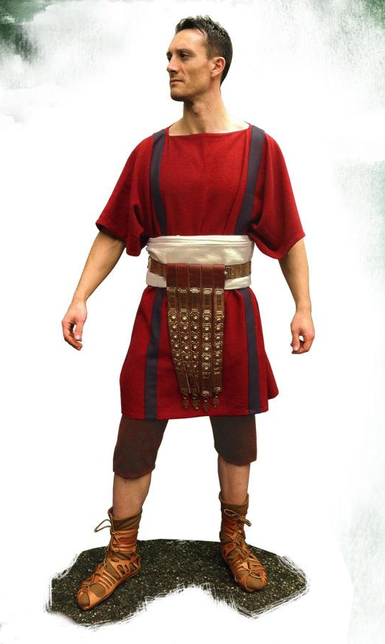
Salvation of the Soul
1 PETER
Our Relation to God Through Obedience - 1:13-16
“Therefore gird up the loins…,” [NKJV]
“gird up” – “to bind about especially with a belt.
“loins” – “the source of procreative power.”
Notes:
The allusion here is to the manner in which the Orientals were accustomed to dress. They wear loose, flowing robes, so that, when they wish to run, or to fight, or to apply themselves to any business, they are obliged to bind their garments close around them.
Barnes' Notes, Electronic Database Copyright © 1997-2014 by Biblesoft, Inc. All rights reserved.)

Slide 16
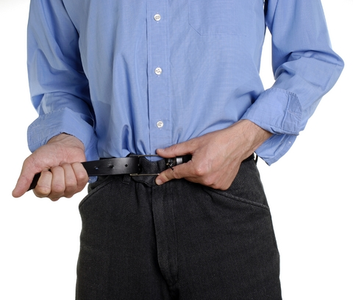
Salvation of the Soul
1 PETER
Our Relation to God Through Obedience - 1:13-16
“Therefore gird up the loins…,” [NKJV]
“Pull up your pants, tuck in your shirt and tighten your belt.” [Modern Vernacular]

Slide 17
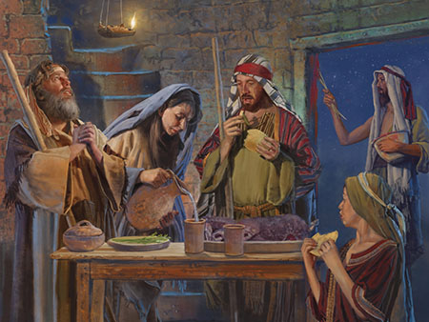
Salvation of the Soul
1 PETER
Our Relation to God Through Obedience - 1:13-16
“Therefore gird up the loins…,” [NKJV]
“And thus you shall eat it: with a belt on your waist, your sandals on your feet, and your staff in your hand. So you shall eat it in haste.” (Exodus 12:11)

Slide 18
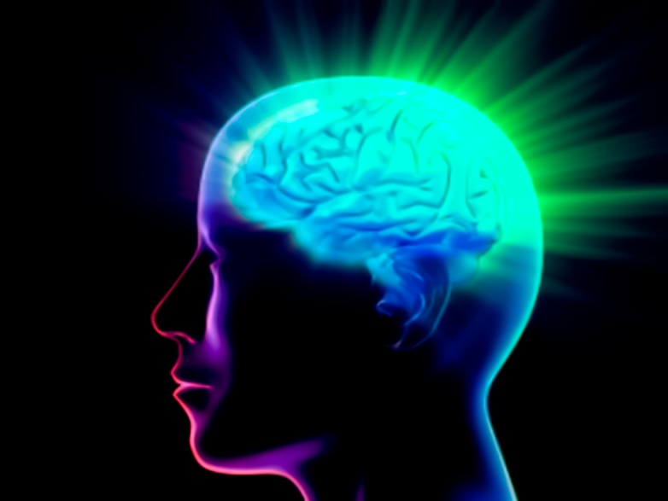
Salvation of the Soul
1 PETER
Our Relation to God Through Obedience - 1:13-16
“Therefore gird up the loins of your mind,”
“mind” – is the source of thought and understanding.
Notes:
“The meaning here is, that they were to have their minds in constant preparation to discharge the duties, or to endure the trials of life - like those who were prepared for labor, for a race, or for a conflict.” (Barnes' Notes, Electronic Database Copyright © 1997-2014 by Biblesoft, Inc. All rights reserved.)
We should not let our minds wander like a flowing garment. Our mind should not be distracted from our major objective, but strictly controlled until the end. We should constantly focus our attention upon the great consummation of our lives in the coming of Christ.

Slide 19
Salvation of the Soul
1 PETER
“My Brother, sister, friend, read, study, think, and read again. You were made to think. It will do you good to think. Develop your powers by study. God designed that religion should require thought, intense thought, and should thoroughly develop our powers of thought. The Bible itself is written in a style so condensed as to require much intense thought.” (Charles Finny)

Slide 20
Salvation of the Soul
1 PETER
Our Relation to God Through Obedience - 1:13-16
“be filled with the Spirit” – “be spiritually minded” or “be filled with spiritual wisdom”
“walk/live not as fools but as wise, but understand what the will of the Lord is” (Eph. 5:17)

Slide 21
Salvation of the Soul
1 PETER
Our Relation to God Through Obedience - 1:13-16
“be filled with the Spirit” – “be spiritually minded” or “be filled with spiritual wisdom”
“Let the word of Christ dwell in you richly in all wisdom” – (Col. 3:16)

Slide 22
Salvation of the Soul
1 PETER
Our Relation to God Through Obedience - 1:13-16
“be sober” – to abstain from wine or drugs, - things that would cloud your thinking.
“Be sober, be vigilant…” (1 Peter 5:1a)
Notes:
“A sober response includes rational and clear thinking that leads to sound judgment rather than panic or flippancy.” Gary Derickson, The Grace NT Commentary, Grace Evangelical Society, Denton, TX, 2010, p. 1148.

Slide 23
Salvation of the Soul
1 PETER
Our Relation to God Through Obedience - 1:13-16
“be sober” – to abstain from wine or drugs, - things that would cloud your thinking.
A sober driver is an alert and safe driver.

Slide 24
Salvation of the Soul
1 PETER
Our Relation to God Through Obedience - 1:13-16
“be sober” – to abstain from wine or drugs, - things that would cloud your thinking.
“Therefore let us not sleep, as others do, but let us watch and be sober”
(1 Thess. 5:6)
Notes:
“For you yourselves know perfectly that the day of the Lord so comes as a thief in the night. For when they say, "Peace and safety!" then sudden destruction comes upon them, as labor pains upon a pregnant woman. And they shall not escape. But you, brethren, are not in darkness, so that this Day should overtake you as a thief. You are all sons of light and sons of the day. We are not of the night nor of darkness. Therefore let us not sleep, as others do, but let us watch and be sober. For those who sleep, sleep at night, and those who get drunk are drunk at night. But let us who are of the day be sober, putting on the breastplate of faith and love, and as a helmet the hope of salvation. For God did not appoint us to wrath, but to obtain salvation through our Lord Jesus Christ, who died for us, that whether we wake or sleep, we should live together with Him.” (1 Thess. 5:2-10)

Slide 25
Salvation of the Soul
1 PETER
Our Relation to God Through Obedience - 1:13-16
“and rest your hope fully upon the grace that is to be brought to you at the revelation of Jesus Christ;” (1:13b)
“Fix your hope completely” – We are to be absorbed in the consummation of our lives in the glory of the Messianic unveiling.

Slide 26
Salvation of the Soul
1 PETER
Our Relation to God Through Obedience - 1:13-16
“Verse 13, then, teaches that our wondering thoughts and pre-occupations of heart are to be carefully drawn in, like the robe of a garment, in order that in a spirit of sobriety they may be fully fixed on the hope of sharing Messiah’s glory.” (Hodges, p. 28-29)

Slide 27
Salvation of the Soul
1 PETER
Our Relation to God Through Obedience - 1:13-16
“and rest your hope fully upon the grace that is to be brought to you at the revelation of Jesus Christ;” (1:13b)
“grace” – “charis” – the most common use is “favor” sometime unmerited, sometimes not.
Notes:
Picks up on the idea found in verse 10 “the grace toward you” which refers to the conclusion of our lives in the glory that is to be brought to us at the disclosing of the Messiah, and the Messianic age.
“It is essential that we get a clear grasp of the glory which by the grace of God we are being prepared for now, and then set that glory before us as the all-consuming expectation of our life.”
Do we live for this age, this evil age, which will soon come to an end, or do we live for the age to come. And how long is the age to come? Forever! Life everlasting! Eternal life.

Slide 28
Salvation of the Soul
1 PETER
Our Relation to God Through Obedience - 1:13-16
“at the revelation of Jesus Christ”

Slide 29
Salvation of the Soul
1 PETER
Our Relation to God Through Obedience - 1:13-16
“at the revelation of Jesus Christ” - Future
“…eagerly waiting for the revelation of our Lord Jesus Christ.” (1 Cor. 1:7)
“The Revelation of Jesus Christ, which God gave Him to show His servants…” (Rev. 1:1)

Slide 30
Salvation of the Soul
1 PETER
Our Relation to God Through Obedience - 1:13-16
“at the revelation of Jesus Christ” - Future
“Behold, He is coming with clouds, and every eye will see Him, even they who pierced Him. And all the tribes of the earth will mourn because of Him. Even so, Amen.” (Rev 1:7)

Slide 31
Salvation of the Soul
1 PETER
Our Relation to God Through Obedience - 1:13-16
“the revelation of Jesus Christ” - Past
Paul says that “the Gospel that was preached” to him came by “the revelation of Jesus Christ,” (Gal. 1:12), but now made manifest, and by the prophetic Scriptures made known to all nations,” (Rom. 16:25-26)
Notes:
“Now to Him who is able to establish you according to my gospel and the preaching of Jesus Christ, according to the revelation of the mystery kept secret since the world began but now made manifest, and by the prophetic Scriptures made known to all nations,” (Rom 16:25-26)

Slide 32
Salvation of the Soul
1 PETER
Our Relation to God Through Obedience - 1:13-16
“the revelation of Jesus Christ” - Past
“But when it pleased God, who separated me from my mother's womb and called me through His grace, to reveal His Son in me, that I might preach Him among the Gentiles… “ (Gal 1:15-16)
Notes:
“revealed” is used 37x’s in the NKJV. The verb “apokalupto” – “to take off the cover” is used 26x’s in the Greek NT.
Paul recalls the revelation of Jesus Christ on the road to Damascus when suddenly a light shone around him from heaven and the three years when he learned the Gospel taught by Christ Himself.

Slide 33
Salvation of the Soul
1 PETER
Our Relation to God Through Obedience - 1:13-16
“the revelation of Jesus Christ” - Past
“For we did not follow cunningly devised fables when we made known to you the power and coming of our Lord Jesus Christ, but were eyewitnesses of His majesty… “ (2 Peter 1:16-18)
Notes:
Peter had already received a glimpse of the Son of Man coming His Kingdom when Jesus was transfigured before him and “His face shone like the sun, and His clothes became as white as the light.” (Matt. 17:2), “and His countenance was like the sun shining in its strength.” (Rev, 1:16).
“For we did not follow cunningly devised fables when we made known to you the power and coming of our Lord Jesus Christ, but were eyewitnesses of His majesty. For He received from God the Father honor and glory when such a voice came to Him from the Excellent Glory: "This is My beloved Son, in whom I am well pleased." And we heard this voice which came from heaven when we were with Him on the holy mountain.” (2 Peter 1:16-17)

Slide 34
Salvation of the Soul
1 PETER
Our Relation to God Through Obedience - 1:13-16
“the revelation of Jesus Christ is…
Past – Special Revelation – 1 Pet. 1:20, Gal. 1:16
Present – General Revelation – Romans 1:18-20
Future – Final Revelation – Rev. 1:1ff, 1 Pet. 4:13

Slide 35
Salvation of the Soul
1 PETER
Our Relation to God Through Obedience - 1:13-16
“as obedient children, not conforming yourselves to the former lusts, as in your ignorance;” (1:14)
“But as many as received Him, to them He gave the right to become children of God, to those who believe in His name.” (John 1:12)
Notes:
By believing we are accepted by God into the family of God. We become a child of God.

Slide 36
Salvation of the Soul
1 PETER
Our Relation to God Through Obedience - 1:13-16
“as obedient children, not conforming yourselves to the former lusts, as in your ignorance;” (1:14)
“obedient children” are children who listen, comply or are submissive to the parent.
Notes:
If we “listen and learn, we will live” By being obedient children we are approved by God.

Slide 37
Salvation of the Soul
1 PETER
Our Relation to God Through Obedience - 1:13-16
“as obedient children, not conforming yourselves to the former lusts, as in your ignorance;” (1:14)
“And do not be conformed to this world, but be transformed by the renewing of your mind.” (Rom 12:2)
Notes:
This is a process that is going on simultaneously with fixing our eyes on our hope / salvation / inheritance of future glory. “…it is only as our hope is fixed that we can truly avoid those lust associated with the ignorance of our unsaved days.” By not fashioning ourselves, (not becoming Jell-O); by not giving in to the evil desires that proceed from flesh (though the flesh/body in itself is not evil, for everything God created was good), our souls can truly escape and be liberated from these lusts by the vision of a higher goal and a greater glory.

Slide 38
Salvation of the Soul
1 PETER
Our Relation to God Through Obedience - 1:13-16
“as obedient children, not conforming yourselves to the former lusts, as in your ignorance;” (1:14)
“It is hope in the future glory that motivates us to be obedient children. And this is the basic principle of our relationship to God.” (Hodge, p. 29)

Slide 39
Salvation of the Soul
1 PETER
Our Relation to God Through Obedience - 1:13-16
“…Therefore, since all these things will be dissolved, what manner of persons ought you to be in holy conduct and godliness, looking for and hastening the coming of the day of God…” (2 Peter 3:10-13)
Notes:
“But the day of the Lord will come as a thief in the night, in which the heavens will pass away with a great noise, and the elements will melt with fervent heat; both the earth and the works that are in it will be burned up. Therefore, since all these things will be dissolved, what manner of persons ought you to be in holy conduct and godliness, looking for and hastening the coming of the day of God, because of which the heavens will be dissolved, being on fire, and the elements will melt with fervent heat? Nevertheless we, according to His promise, look for new heavens and a new earth in which righteousness dwells.” (2 Peter 3:10-13)
Eschatology, properly conceived, is the primary NT motivation for obedient living. Not what we gain now (for we now suffer), but what we gain / profit hereafter is what encourages us to live to God, and not for ourselves, for whoever seeks to save his life will lose it, but whoever lives for God will save is life/soul.
Peter motives the us with forward looking thinking, getting us to see what we will gain in the future by enduring the present.

Slide 40
Salvation of the Soul
1 PETER
Our Relation to God Through Obedience - 1:13-16
“but as He who called you is holy, you also be holy in all your conduct, because it is written, ‘Be holy, for I am holy.” (1:15-16)
Peter quotes Leviticus 19:20 or 20:7 which gives instruction for holy “set apart” living by a people who have been redeemed.
Notes:
Peter is saying that God continues to make the same demands of those He calls and redeems today.
Peter exhorts as Paul did to “…walk worthy of God who calls you into His own kingdom and glory.” (1 Thess. 2:12) If our minds are fixed on the future historical, literal kingdom of earth, we will find motivation to be like Him who called us, namely to be holy, set apart to righteousness and justice in our conduct.

Slide 41
Salvation of the Soul
1 PETER
Our Relation to God Through Fear - 1:17-21
“And if you call on the Father, who without partiality judges according to each one's work, conduct yourselves throughout the time of your stay here in fear;” (1:17)
Notes:
There is a difference between obedience and fear. Obedience is more external and fear stress the internal, the disposition that issue in obedience.

Slide 42
Salvation of the Soul
1 PETER
Our Relation to God Through Fear - 1:17-21
“And if you call on the Father, who without partiality judges according to each one's work,”
Everyone who calls on God is expected to conduct their life in awed fear.
Notes:
If you call on the Father for help, appeal to Him, remember your appeal is to a Judge, Who is utterly impartial and rewards according to your works. So fear Him!

Slide 43
Salvation of the Soul
1 PETER
Our Relation to God Through Fear - 1:17-21
“conduct yourselves throughout the time of your stay here”
Once again this refers to our status as temporary aliens/strangers in a foreign land, our eye is ever on our future homeland.

Slide 44
Salvation of the Soul
1 PETER
Our Relation to God Through Fear - 1:17-21
“conduct yourselves throughout the time of your stay here”
“live your lives as strangers here in reverent fear.” [NIV]
“pass the time of your sojourning here in fear:” [KJV]

Slide 45
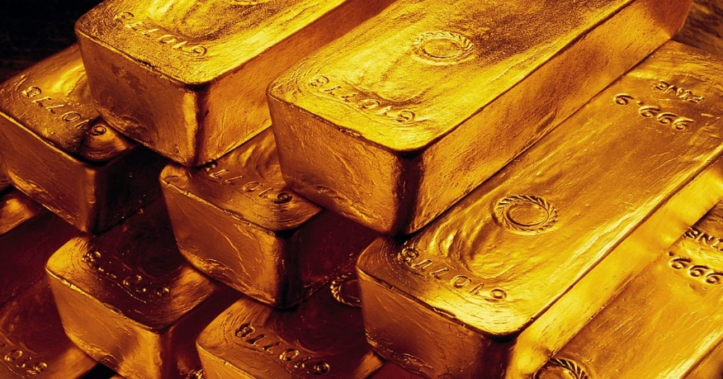
Salvation of the Soul
1 PETER
Our Relation to God Through Fear - 1:17-21
“knowing that you were not redeemed with corruptible things, like silver or gold, from your aimless conduct received by tradition from your fathers,” (1:18)
Notes:
“Since you know” introduces the first rich doctrinal section of the body of the epistle. Peter is motivating through doctrinal content. We conduct our lives accordingly because we know. And what is it that we know? Are redemption was very costly, more valuable than silver or gold.

Slide 46
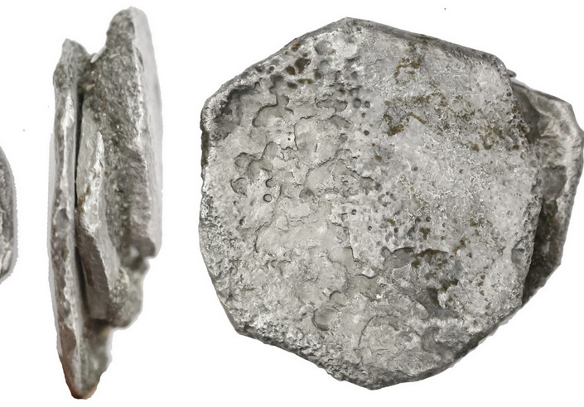
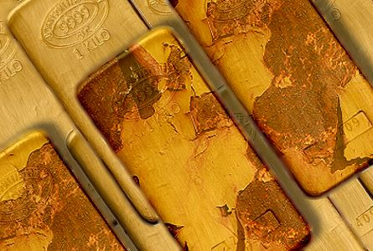
Salvation of the Soul
1 PETER
Our Relation to God Through Fear - 1:17-21
“not redeemed with corruptible things, like silver or gold,
Notes:
We know that we were “not redeemed” with silver and gold which is corruptible, which can corroded over time, earthly riches of this age are not eternal.

Slide 47
Salvation of the Soul
1 PETER
Our Relation to God Through Fear - 1:17-21
“Your riches are corrupted, and your garments are moth-eaten. Your gold and silver are corroded, and their corrosion will be a witness against you and will eat your flesh like fire. You have heaped up treasure in the last days.” (James 5:2-3)
Notes:
James reminds the rich that their riches will be poisoned, so much so that people will heap them into great piles in the last days (James 5:2-3). We are in the last days now, but not everything that will happened in the last days has happened yet.

Slide 48
Salvation of the Soul
1 PETER
Our Relation to God Through Fear - 1:17-21
“For as in the days before the flood, they were eating and drinking, marrying and giving in marriage, until the day that Noah entered the ark, and did not know until the flood came and took them all away, so also will the coming of the Son of Man be.” (Matt 24:38-39)
Notes:
Are we in the days of Noah? We live in the days before the flood, before sudden destruction came upon them. Noah has yet to entered the ark, the day of the Lord has yet to come upon us. When the day of the Lord begins those living on the earth at that time will be living in a day just as in the day Noah entered the ark.

Slide 49
Salvation of the Soul
1 PETER
Our Relation to God Through Fear - 1:17-21
“For you yourselves know perfectly that the day of the Lord so comes as a thief in the night. For when they say, "Peace and safety!" then sudden destruction comes upon them…” (1 Thess. 5:2-3)

Slide 50
Salvation of the Soul
1 PETER
Our Relation to God Through Fear - 1:17-21
“knowing that you were… redeemed… from your aimless conduct received by tradition from your fathers,” (1:18)
“redeemed” – the purchase necessary in order to release a slave or prisoner from bondage.
Notes:
In this case it is the price paid to release us from an aimless life and conduct.

Slide 51
Salvation of the Soul
1 PETER
Our Relation to God Through Fear - 1:17-21
“knowing that you were… redeemed… from your aimless conduct received by tradition from your fathers,” (1:18)
“your fathers” – more than likely refers a description of Gentiles and their inherited modes of conduct.

Slide 52
Salvation of the Soul
1 PETER
Our Relation to God Through Fear - 1:17-21
“Our fear of God and conformity to His will, ought certainly to arise from, and sustained by, a realization of the costliness to Him of our redemption. Our lives will be judged by this impartial God and Father in light of that price.” (Hodges, p. 31)
Notes:
We will also be judged by the Law of Liberty, not by the Mosaic Law.

Slide 53
Salvation of the Soul
1 PETER
Our Relation to God Through Fear - 1:17-21
“but redeemed with the precious blood of Christ, as of a lamb without blemish and without spot.” (1:19)
This reflects the requirement of a perfect and undefiled sacrifice.

Slide 54
Salvation of the Soul
1 PETER
Our Relation to God Through Fear - 1:17-21
“He indeed was foreordained before the foundation of the world, but was manifest in these last times for you” (1:20)
This was God’s plan from the beginning, before the beginning of created time, and finds fulfilment at the end of time.
Notes:
He, Christ’s death as a sacrificial lamb to bring redemption to mankind was God’s eternal plan from the beginning, before the beginning of created time, and finds fulfilment at the end of time.

Slide 55
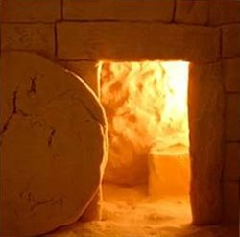
Salvation of the Soul
1 PETER
Our Relation to God Through Fear - 1:17-21
“who through Him believe in God, who raised Him from the dead and gave Him glory, so that your faith and hope are in God.” (1:21)

Slide 56
Salvation of the Soul
1 PETER
Our Relation to God Through Fear - 1:17-21
“who through Him believe in God,”
Faith in God is through Jesus who provided the provision for sin and paid the price for our redemption. He is the only way to God the Father and for ongoing fellowship with Him.

Slide 57
Salvation of the Soul
1 PETER
Our Relation to God Through Fear - 1:17-21
“who raised Him from the dead and gave Him glory,”
The Father raised Jesus from the dead, declaring Him to be the Son of God with power (Romans 1:4). “To Him be the glory and the dominion forever and ever. Amen.” (1 Peter 5:11)

Slide 58
Salvation of the Soul
1 PETER
Our Relation to God Through Fear - 1:17-21
“who raised Him from the dead”
“…but He whom God raised up saw no corruption” (Acts 13:37), “…the God and Father of our Lord Jesus Christ has begotten us again to a living hope through the resurrection of Jesus Christ from the dead,” (1 Peter 1:3-4)
Notes:
Because of Christ’s resurrection from the dead the Father is able to grant us life everlasting. “I am the resurrection and the life. He who believes in Me, though he may die, he shall live. And whoever lives and believes in Me shall never die.” (John 11:25-26)

Slide 59
Salvation of the Soul
1 PETER
Our Relation to God Through Fear - 1:17-21
“and gave Him glory,”
“If we suffer with Christ we will also become a partaker of the glory that will be revealed” (1 Peter 5:1) “and when the Chief Shepherd appears, you will receive the crown of glory that does not fade away.” (5:4)
Notes:
God the Father gave Him glory. We can also received the same glory if we suffer with Him.

Slide 60
Salvation of the Soul
1 PETER
Our Relation to God Through Fear - 1:17-21
“so that your faith and hope are in God.”
The Father’s resurrection and the glorification of Jesus results in faith and hope being in God. They are directed toward, or focused on God.
Notes:
We are saved by faith alone in Christ alone. And the desire or motivation to live for Him, to live our lives in holy conduct springs from a real hope in God – that He will keep His promise to ultimately save and give glory to those who endure sufferings.

Slide 61
Salvation of the Soul
1 PETER
Conclusion

Slide 62
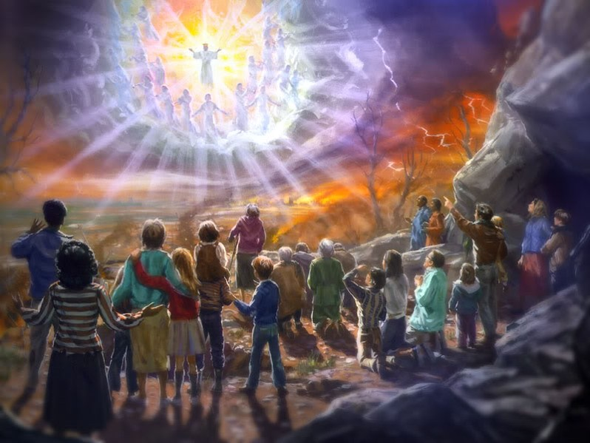
Salvation of the Soul
1 PETER
the believer is to become an obedient and holy child of God, maintaining a reverent fear of His impartial Father who will judge our works for their true worth.
By fixing our eyes on the Revelation of Jesus Christ…

Slide 63
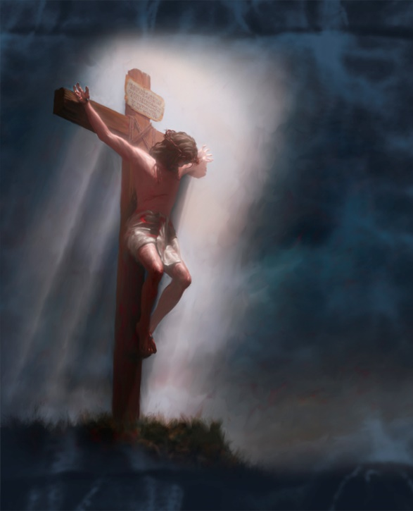
Salvation of the Soul
1 PETER
“The Christians fear of God
springs from the awesome price
of redemption, the awesome purpose of foreknowledge and the awesome principle of faith in God of resurrection and glory. The price is infinite, the purpose is eternal and the principle is divine.”

Slide 64
Salvation of the Soul
1 PETER
“The stress of this section
falls on the child-father
relationship. Thus, having been born again, the first area of life in which we ought to experience the salvation of the soul is that of the child-parent relationship which the new birth creates.” (Hodges, p. 33)

Slide 65
Salvation of the Soul
1 PETER
Our goal, the end of our faith, is the salvation of the soul which is the total transforming work of God upon our lives, which is presently being realized in the midst of Christ like suffering, and which in the future will be unveiled in Christ like glory.

